Slide 1
Winning Space Race with Data Science
IBM Applied Data Science Capstone
Tyler Lee Ang ren
7th November 2024
https://github.com/TylerKoN

Slide 2

OUTLINE of project
Executive Summary
Introduction
Methodology
Results
Conclusion
Appendix

Slide 3
Executive Summary
The current project has utilized the public SpaceX API and web-scraping from the SpaceX Wikipedia for data collection. The column ‘class’ was created to indicate the general outcome of landing. The data were explored with visualizations from python libraries, SQL queries, Folium maps and a Plotly Dash Dashboard. Machine Learning were then performed on the data with GridSearchCV for the best parameters, standardizing data, and measured accuracies of each models for the best model. The accuracies of models were then visualized
Four machine learning models (Logistic Regression, Support Vector Machine, Decision-Tree Classifier, and K-Nearest Neighbors) were produced to perform classification prediction on the dataset. All models have produced similar results of 83.33% of model accuracy. The confusion matrix has shown a similar prediction across all model with only 3 false positives prediction. The results have suggested that more samples are needed for a better model accuracies.

Slide 4
Introduction
Project Background and context
As the commercial space age arrives, more companies are making travel in space possible and affordable for everyone.
SpaceX being the most successful one of all, was able to reuse their first stage landings, and save up costs of over 100 millions as compared to other providers.
Space Y, plans to compete with SpaceX
Problem Statement
As the first stage are the most expensive, we are to predict the success rate of the first stage
To determine the price of each launch from the success rate of the first stage
To predict whether if SpaceX will reuse the first stage

Slide 5

Methodology
Section 1

Slide 6
Methodology
Executive Summary
Data collection methodology:
Data was collected and combined from SpaceX public API and Web-scraped from SpaceX Wikipedia page
Perform data wrangling
A new column labelled “class” was added to classify successful and unsuccessful landings
Perform exploratory data analysis (EDA) using visualization and SQL
Perform interactive visual analytics using Folium and Plotly Dash
Perform predictive analysis using classification models
Models were built upon GridSearchCV after standardizing the data to locate the best parameters of each models
The models’ Accuracy, Jaccard-score, and F1-score were measured to find the best models

Slide 7
Data Collection (Overview)
The current project has utilized the request of SpaceX API and Web-Scraping from SpaceX Falcon 9 Launch Wikipedia page as the methods of data collection.
The step-by-step method of each data collection process will be presented in a Flow Chart format in the following pages
The following are the data columns extracted from the data collection processes:
SpaceX API request Data:
Date, BoosterVersion, PayloadMass, Orbit, LaunchSite, Outcome, Flights, GridFins,
Reused, Legs, LandingPad, Block, ReusedCount, Serial, Longitude, Latitude, FlightNumber
Web-Scraping from Falcon 9 Launch Wikipedia
Flight No., Date, Time, Version Booster, Launch site, Payload, Payload mass, Orbit, Customer, Launch outcome, Booster landing.

Slide 8
Data collection – spacex api
Requesting SpaceX API Contents
Convert API contents into JSON Format
Json_normalize into pandas DataFrame
Filtering relevant data features for DataFrame
Converting data types to relevant respective data types
Constructing dataset with dictionary of relevant data
Casting dictionary into DataFrame
Filtering data for Falcon 9 Rocket Launches only
Replaced missing values from Payload Mass with Mean value
Flow Chart of the Data Collection process via SpaceX public API
Github URL
https://github.com/TylerKoN/Data-Science-Capstone/blob/main/Data%20Collection/SpaceX%20Data%20Collection%20API.ipynb

Slide 9
Data collection – web scraping
Requesting HTML page from Wikipedia
Creating beautiful soup html parser
Locating Launch information from html tables
Creating dictionaries for data columns
Creating Iterating function to extract data from table cells
Extracting data into respective dictionaries through iterations
Casting Dictionary into pandas DataFrame
Flow Chart of the Data Collection process via Web-Scraping of SpaceX Wikipedia page
Github URL
https://github.com/TylerKoN/Data-Science-Capstone/blob/main/Data%20Collection/WebScraping.ipynb

Slide 10
Data wrangling
Flow Chart of the Data Wrangling process.
Outcome columns are separated into two columns
Column “class” are created for better classification of outcome
Value Mapping:
True ASDS, True RTLS, True Ocean = 1
None None, False ASDS, None ASDS, False ocean, False RTLS = 0
Github URL
https://github.com/TylerKoN/Data-Science-Capstone/blob/main/Data%20Collection/Data%20Wrangling.ipynb
Identifying outcome components in Outcome column
Identifying and creating set of bad outcomes
Creating landing class variable to classify outcomes
Casting landing class variable into column “class”
Separating outcome components to landing locations and mission outcome

Slide 11
EDA with Data visualization
Exploratory Data Analysis was performed on the Dataset, with variables such as Payload Mass (kg), Flight number, Launch site, Orbit, Date, and Class. The plots used in this project are:
4x Scatter Plots
1x Bar Chart
1x Line Chart
To measure the relationship between the variables in question for further training in machine learning model such as:
Flight Number vs. Launch Site
Payload Mass vs. Launch site
Success rate of each Orbit Type
Flight Number vs. Orbit Type
Payload Mass vs. Orbit Type
Launch Success Yearly Trend
Github URL
https://github.com/TylerKoN/Data-Science-Capstone/blob/main/EDA/EDA%20with%20Data%20Viz.ipynb

Slide 12
EDA with SQL
Loaded SQL extension and established a connection with the Database
Exploratory Data Analysis were performed with SQL queries with Python integration
Dataset were filtered for better understanding with SQL queries, showing information about:
Total Payload Mass carried by Boosters launched by NASA (CRS)
Average Payload mass carried by booster version F9 v1.1
Date of first successful ground pad landing
Total number of successful and failure mission outcome
Booster Versions that have carried the maximum Payload Mass
And more
GitHub URL
https://github.com/TylerKoN/Data-Science-Capstone/blob/main/EDA/EDA%20with%20SQL.ipynb

Slide 13
Building interactive map with folium
Markers have been added into the Folium map indicating the location of the 4 launch sites, alongside with colored circles that indicate the launch outcomes.
Lines were also included for estimating distance between Launch sites and key locations such as Railway, Highway, Cities, and Coastline.
These specific elements were included as it will allow us to understand better on the specific landmarks and criteria of Launch Sites,
Understanding the factors behind the best Rocket Launching locations, and potentially predict landings’ success ratio from its location.
GitHub URL
https://github.com/TylerKoN/Data-Science-Capstone/blob/main/Visual%20Analytics%20and%20Dashboard/Launch%20site%20location%20Folium.ipynb

Slide 14
Building a dashboard with plotly dash
The Plotly Dash Dashboard were created with two charts for visualization and analysis, being a Scatterplot and a Pie Chart.
The Pie Chart from the Dashboard would display the distribution of successful landing across all launch sites and were given the ability to display the success ratio of each individual launch sites.
The Scatterplot from the Dashboard would display the success ratio based on two inputs:
Payload Mass with a Range Slider from 0kg to 10000kg
Each individual Launch Sites or All launch sites
Both Charts in this case helps visualizing the success ratio of each Launch Sites, with the Scatterplot being able to display success ratio across various variables such as Payload Mass, Booster Version Categories, and Launch sites.
GitHub URL
https://github.com/TylerKoN/Data-Science-Capstone/blob/main/Visual%20Analytics%20and%20Dashboard/spacex_dash_app.py

Slide 15
Predictive analysis (classification)
Separating the “class” column from the dataset
Standardize, Fit, and Transform the features from the dataset
Splitting the data into Training and Testing sets with Train_test_split
Performing GridSearchCV across all models
Measure the accuracy of models with the best parameters
Plotting Confusion Matrix across all models
Locating the best performing model from further scoring analysis
Visualizing the models’ performance with the application of bar plot
Flow Chart of the Classification Predictive Analysis Process:
All models performed similarly with similar score on each scoring categories
GitHub URL
https://github.com/TylerKoN/Data-Science-Capstone/blob/main/Predictive%20Analysis/Classification%20Predictive%20Analysis.ipynb

Slide 16
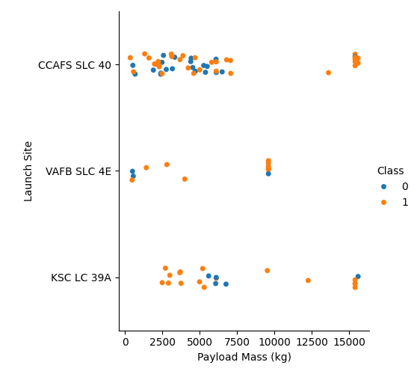
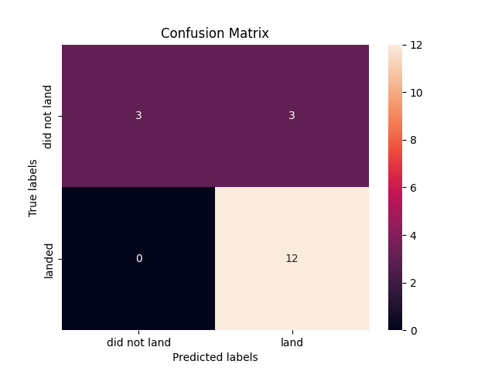
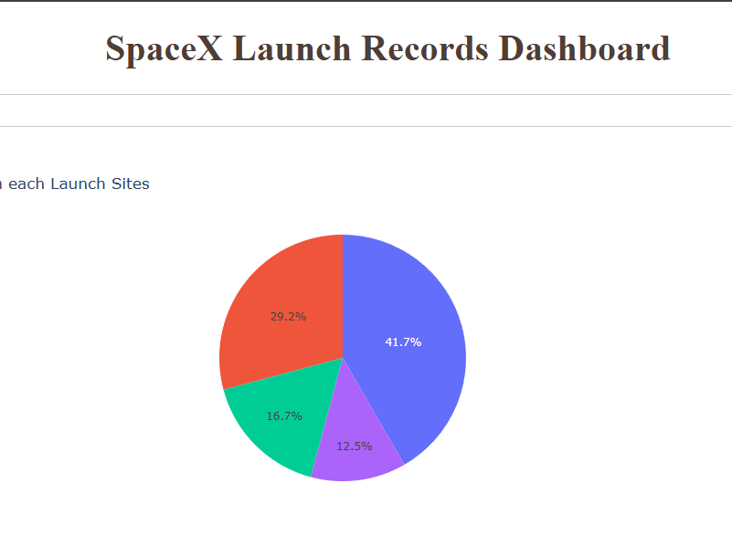
Results
Below is the examples of results displayed from each section.
Exploratory data analysis
SpaceX Launch Records Interactive Dashboard
Predictive Analysis Confusion Matrix

Slide 17

Insights drawn from eda
Section 2

Slide 18
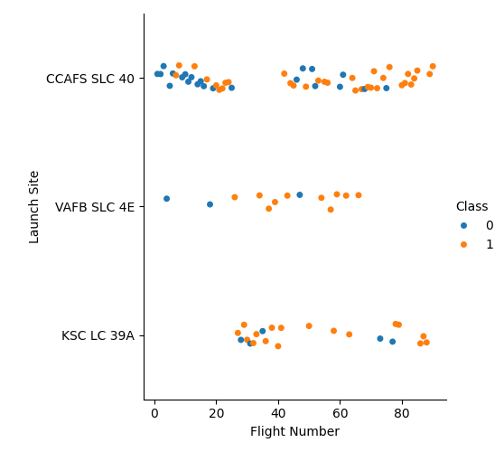
Flight number vs. launch sites
Class 0 (blue) suggests Unsuccessful landings
Class 1 (orange) suggests Successful landings
Explanation
CCAFS SLC 40 Launch site has the most landings across the other launch sites
It is shown that CCAFS SLC 40 launch site has more failure in landing outcomes at an early stage of flight number, with its success rate increasing after 80 flights
The rest of the launch sites has shown more successful landing outcomes than unsuccessful outcomes

Slide 19
Payload vs. launch site
Class 0 (blue) suggests Unsuccessful landings
Class 1 (orange) suggests Successful landings
Explanation
KSC LC 39A Launch Site appears to land successfully with payload mass are within 2500 to 5000kg
Both KSC LC 39A and CCAFS SLC 40 Launch Sites have a higher success rate when it comes with higher Payload Mass at 15000kg+
It seems that VAFB SLC 4E Launch site has a higher landing success ratio with payload mass of below 10000kg
Yet, VAFB SLC 4E Launch site were the launch site that has the least amount of landing as compared to other Launch sites

Slide 20
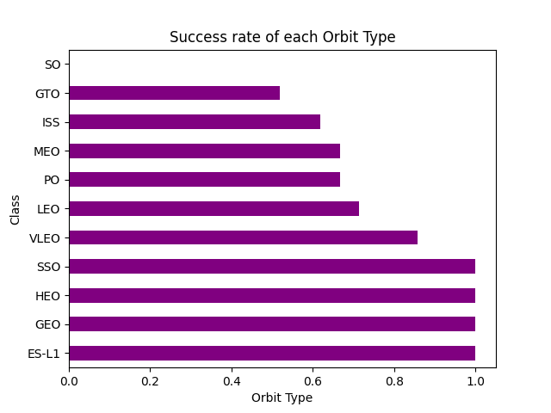
Success rate vs. orbit type
Explanation
The bar chart displayed has shown a perfect success rate of landing outcomes on the orbits (ES-L1, GEO, HEO, and SSO)
Besides, almost all but except SO orbit has equal and above 50% rate of successful landing
SO are the only orbit type that has displayed 0% rate of success in landing outcome
GTO, being the orbit type with the most sample (27), has the success rate of 50%
VLEO with 14 samples, second only to GTO being the most sample, have displayed a great success rate of more than 80%

Slide 21
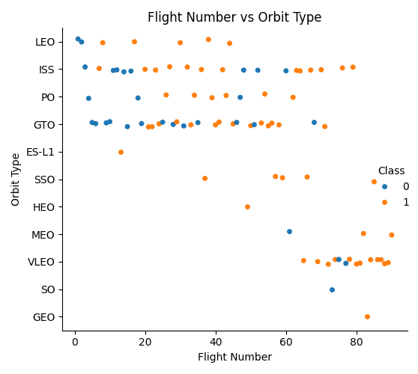
Flight number vs. orbit type
Class 0 (blue) suggests Unsuccessful landings
Class 1 (orange) suggests Successful landings
Explanation
According to the scatter plot, it shows that when flight number increases, most successful landings appears to be within the VLEO orbit
There is also a pattern of unsuccessful landings around the orbit type of LEO, ISS, PO, and GTO during the early stages of Falcon 9 Launches
ES-L1, SSO, and HEO orbits have also showcased a 100% success ratio of landings despite having a relatively smaller sample size.
GTO orbit was also shown to be the orbit type with the most unsuccessful landings (50%)

Slide 22
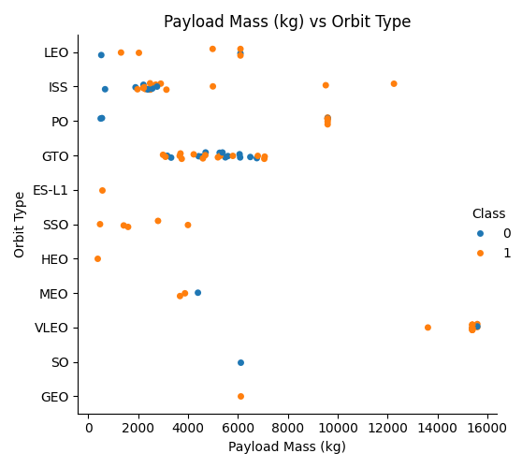
Payload vs. orbit type
Class 0 (blue) suggests Unsuccessful landings
Class 1 (orange) suggests Successful landings
Explanation
The scatterplot has shown the VLEO orbit were often utilized for launches with larger payload mass
ES-L1, SSO, and HEO orbits were shown to have more successful landings with payload mass of 0kg to 6000kg
It is also shown that LEO, ISS, and PO orbit were able to land successfully when payload mass are between 5000kg to 10000kg
The GTO orbit were generally utilized for payload mass of 2000 to 8000kg, with only a 50% rate of successful landing

Slide 23
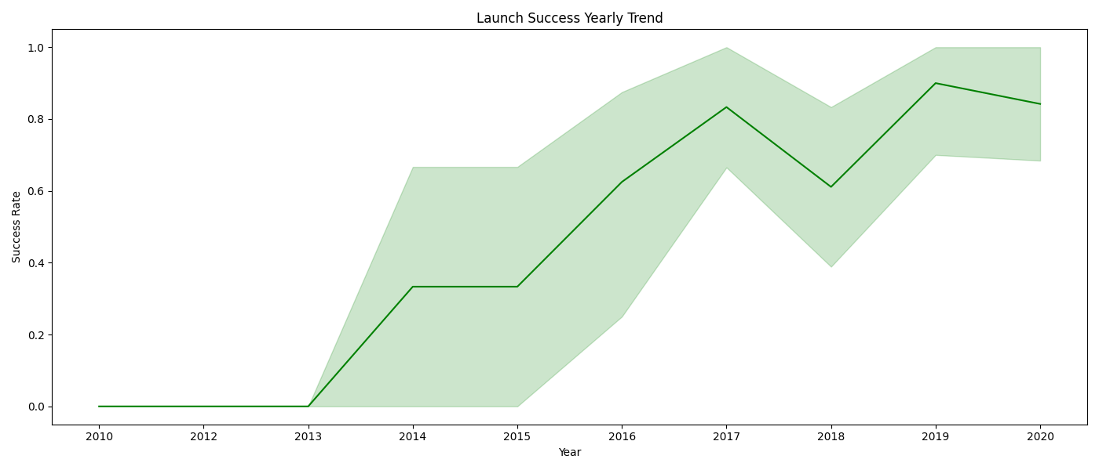
Launch success yearly trend
Based on the line graph, the launch success ratio started to increase from the year 2013 onwards and has gradually improved until 2017, where the performance dropped slightly in 2018 before increasing in 2019 again.
The year 2019 can be seen as the year with the highest launch success ratio, with over 80% of launch success ratio.

Slide 24
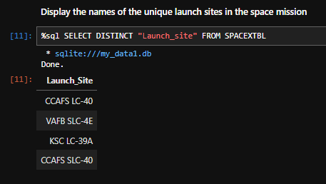
All launch sites names
The query below displayed all the unique values within the “Launch_site” column
4 names of launch sites can be identified from the column, being:
CCAFS LC-40, VAFB SLC-4E, KSC LC-39A, and CCAFS SLC-40

Slide 25
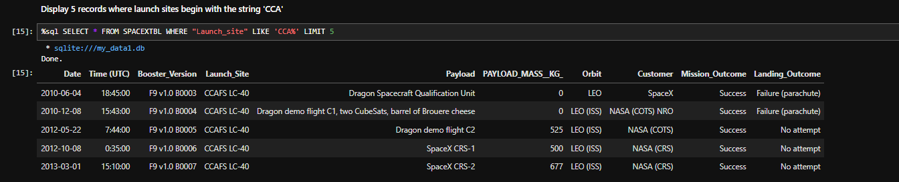
Launch site names begin with ‘cca’
The query below displayed the top 5 records of launch sites name beginning with “CCA”

Slide 26
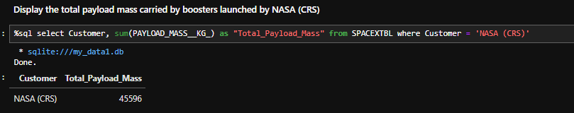
Total payload mass
The query below has displayed the sum for total payload mass that was carried by boosters launched by NASA (CRS)
The total amount of Payload Mass that is carried by NASA (CRS)’s Boosters towards the International Space Station (ISS) was shown to be 45596kg

Slide 27
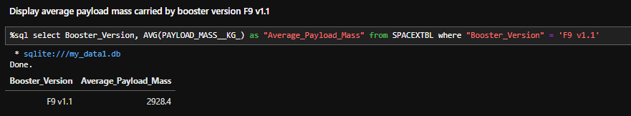
Average payload mass by f9 v1.1
The query below has displayed the average payload mass that was carried by booster version F9 v1.1 with the usage of average function.
The average amount of Payload Mass that is carried by Booster version F9 v1.1 were shown to be 2928.4kg, which was relatively low based on the average value of payload mass from the entire dataset (6138.29kg)

Slide 28
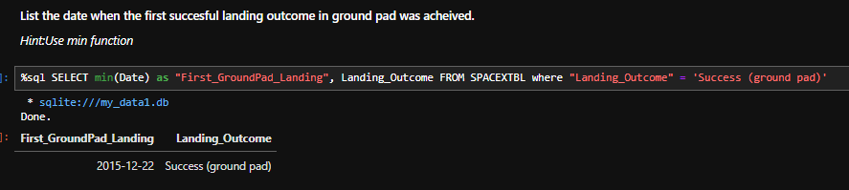
First successful ground landing date
The query below has displayed the date of the first successful landing outcome on a ground pad with the utilization of the “min” function
The first successful ground pad landing date were shown to be on 22nd of December in the year 2015.

Slide 29
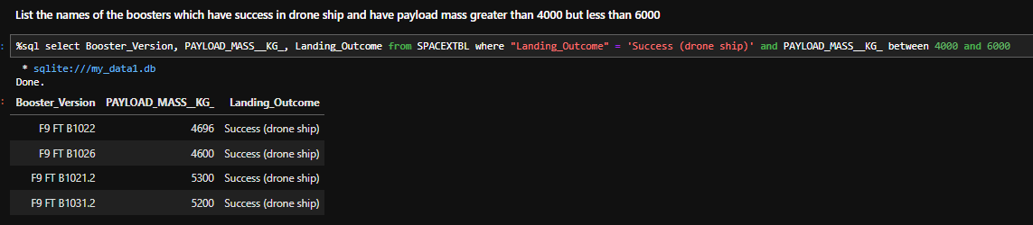
Booster Versions of Successful Drone Ship Landing with Payload between 4000 and 6000
The query below has displayed the list of successful drone ship landing booster versions with the payload mass of between 4000kg to 6000kg
It is shown that the booster versions of successful drone ship landing were F9 FT B1022, B1026, B1021.2, and B1031.2, all of which have carried payload that weighted between 4000kg and 6000kg

Slide 30
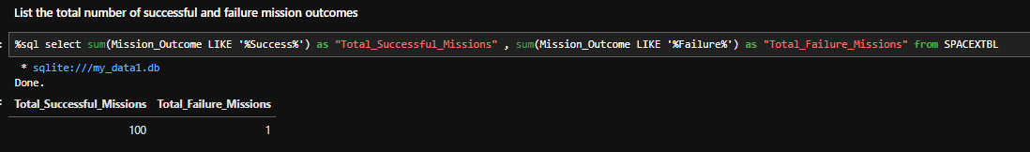
Total Number of Successful and Failure Mission Outcomes
The query below has displayed total number of successful missions and failure mission outcomes with the “sum” function that locates any values that associated with “success” and “failure”
It is shown that SpaceX has only had one mission failure outcome, with the indicator of the mission failure being “Failure in flight”, showcasing a 99% rate of mission success ratio.

Slide 31
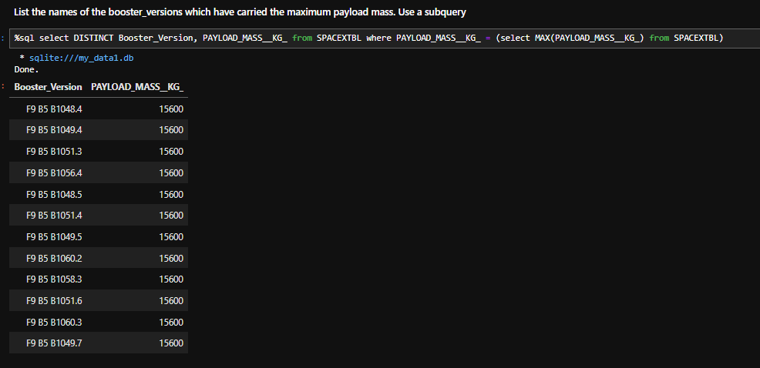
Boosters Carried Maximum Payload
The query below has displayed the list of Boosters Version that has carried the maximum payload mass of 15600kg

Slide 32
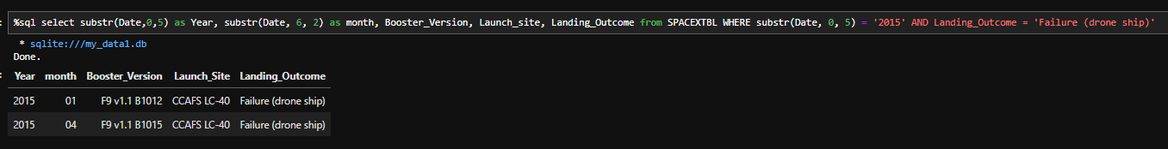
2015 launch records
The query below has displayed launch records in 2015 where the landing outcomes were failure in drone ship, along with its Launch site, booster version, and date.
It is shown only two records of such outcome were recorded in 2015, in which both has occurred in the same Launch Site during January and April of 2015.

Slide 33
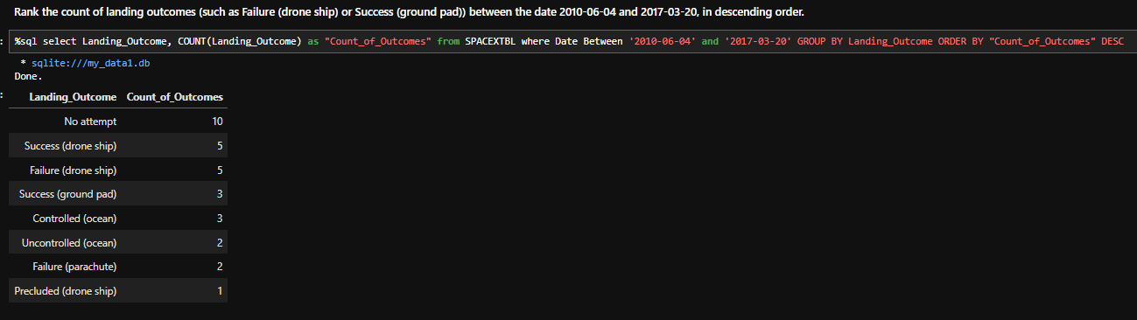
Rank Landing Outcomes Between 2010-06-04 and 2017-03-20
The query below has displayed the count of landing outcomes ranked from most to least during 4th of June 2010 to 20th of March 2017.
The table below shows that most landing outcomes were counted as No attempt, in which showcased that most landing of launches were not even attempted (10) by SpaceX

Slide 34

Launch sites proximities analysis
Section 3

Slide 35
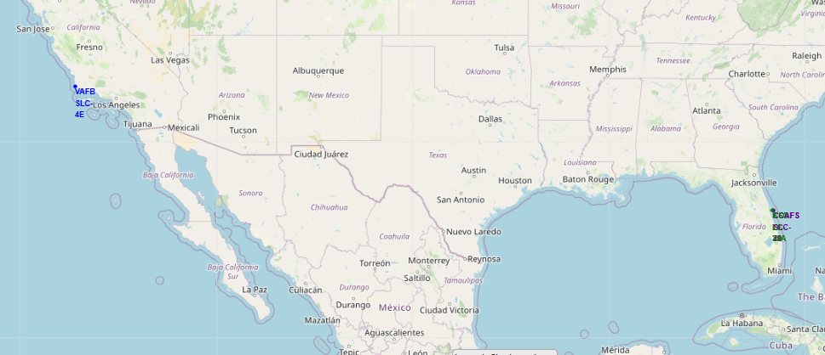
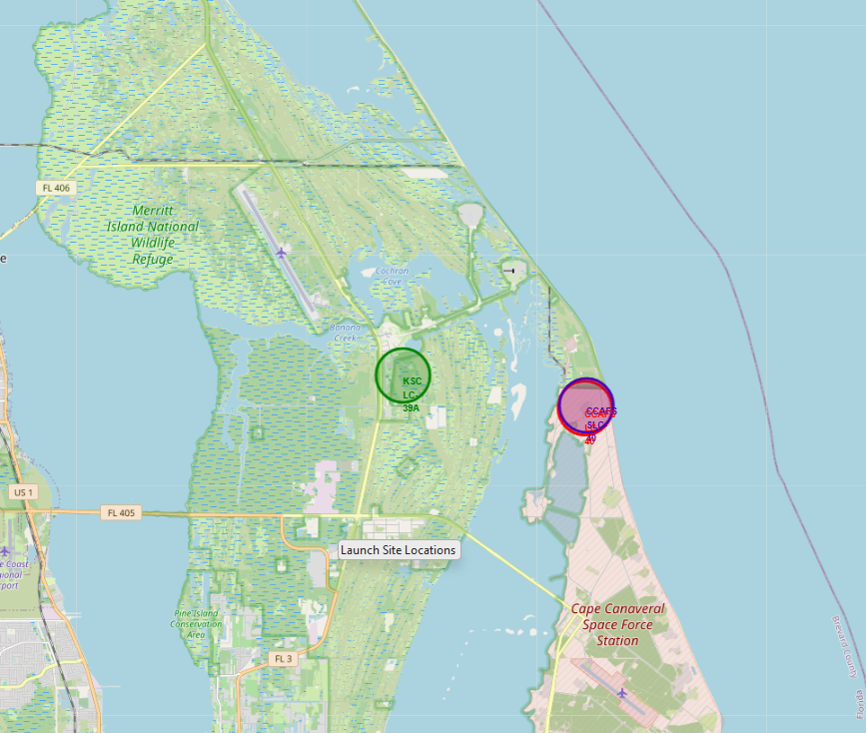
Location of Launch Sites
The folium map above showcases the locations of all Launch sites across the US, where only VAFB SLC-4E can be noticed as the only Launch Site that is on the west side of the country, while the other launch sites were relatively close to each other on the east side of the country.
All launch sites can be seen as closer to the coastline and isolated from large cities

Slide 36
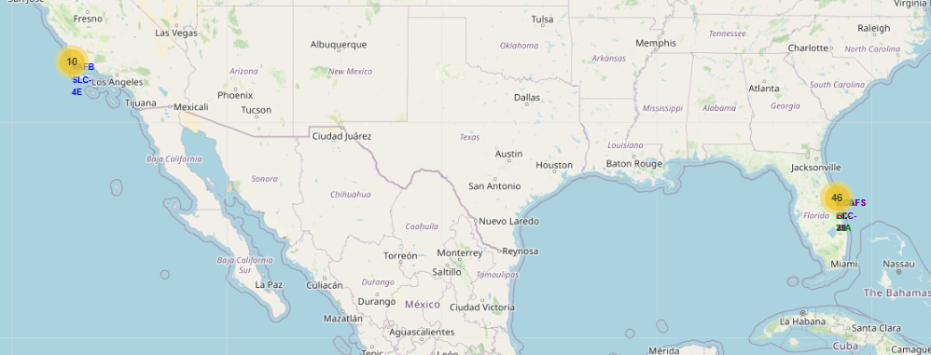
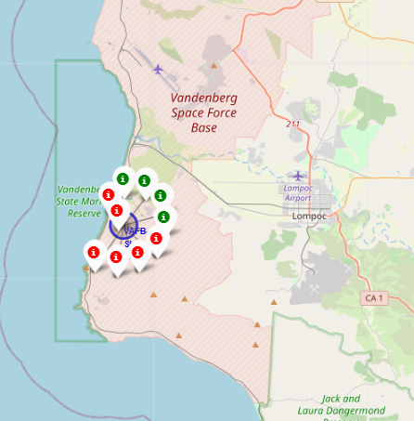
Launch Markers with color indicators
The folium map above showcases the markers for the locations of all successful and unsuccessful launches from each launch sites with colors indicating its outcome.
We can see the launch site VAFB SLC-4E only had 10 launches, with most landing outcomes being unsuccessful as shown from the image above.

Slide 37
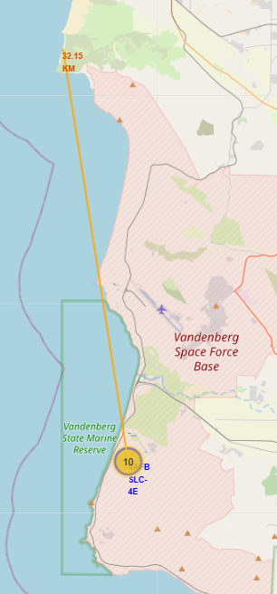
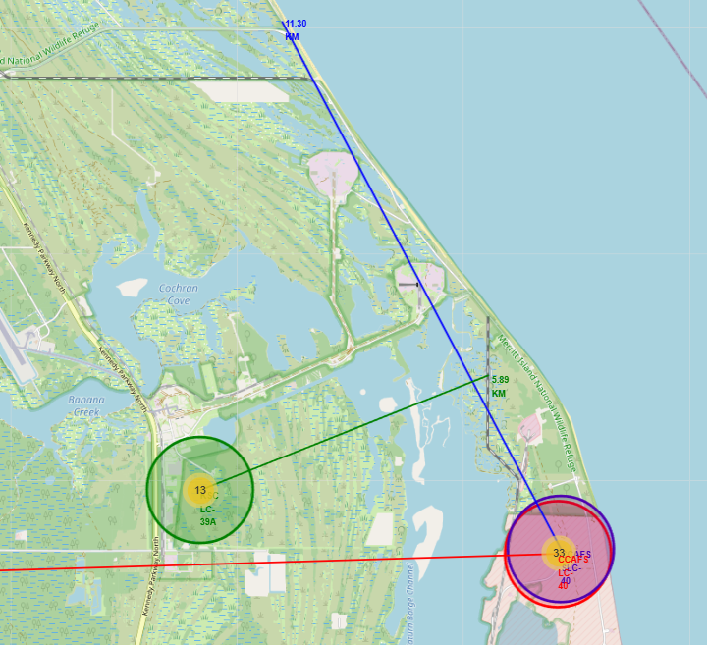
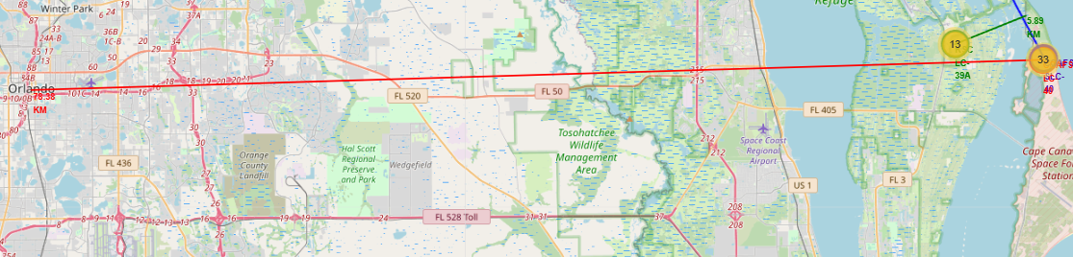
Distance between launch sites and Key Locations
The folium map above showcases the distance between launch sites and some key locations as shown from a line with a remark that indicates the total distance between the launch sites and key locations.
It is noticeable that the Launch Sites are all in close proximity to Railways, highways, and coastlines (Except KSC LC-39A). Possibly to ease the transportation for each launch missions especially when there is payload.
All Launch Sites can be seen as keeping quite a distance away from cities.

Slide 38
Building a dashboard with plotly dash
Section 4

Slide 39
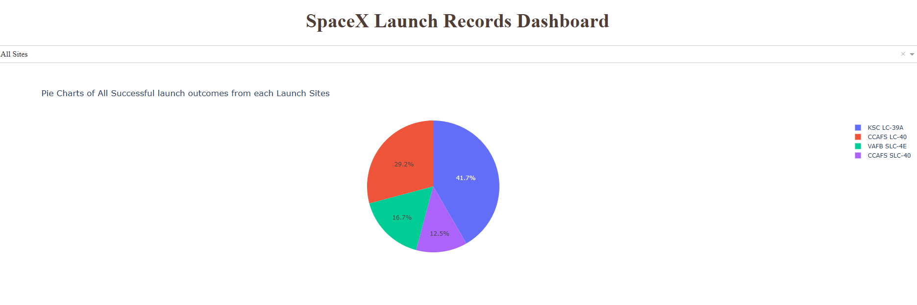
Success ratio of each launch sites
The Pie chart above showcases the landing success outcome ratio for each launch sites, with KSC LC-39A being the highest rated successful landing outcome launch site with 41.7%.
However, it should be noted that CCAFS LC-40 and CCAFS SLC-40 could potentially be a similar launch site that should be compared along each other due to their close proximity with one another, making their total success ratio being 41.7%, same as KSC LC-39A

Slide 40
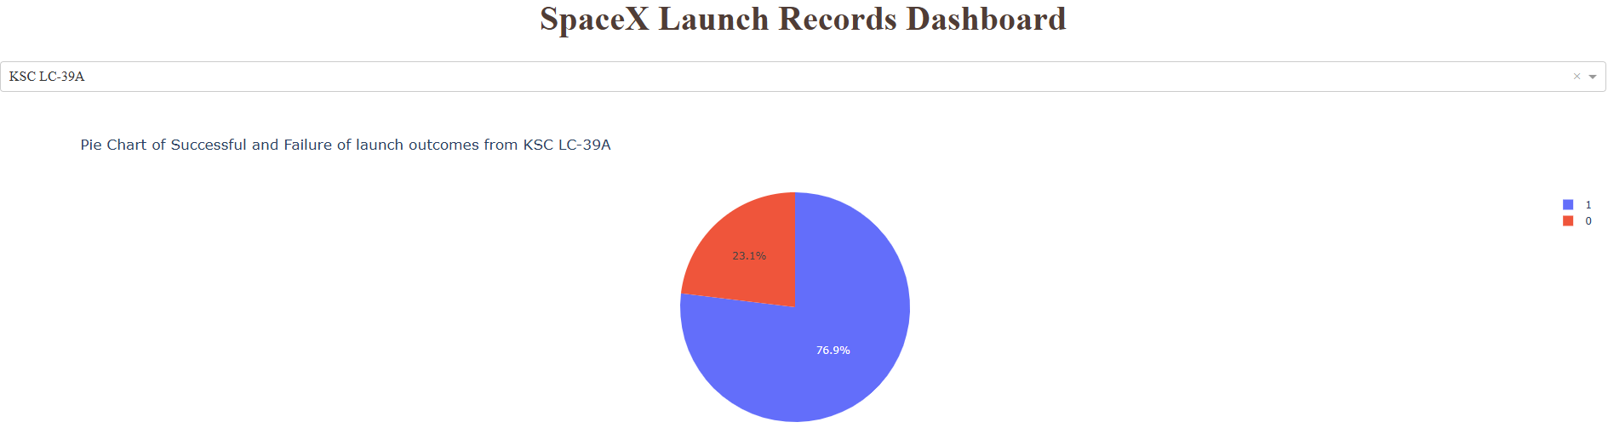
launch site with highest Success ratio
The Pie chart above showcases the landing success outcome ratio for KSC LC-39A launch site, with 76.9% of its landing outcomes being successful, making it the launch sites with the highest success ratio in launch outcomes.
KSC LC-39A achieved the highest successful landing outcome with a total of 13 launches, in which 10 of the launches have landed successfully, and only 3 of the launches have failed its landing.

Slide 41
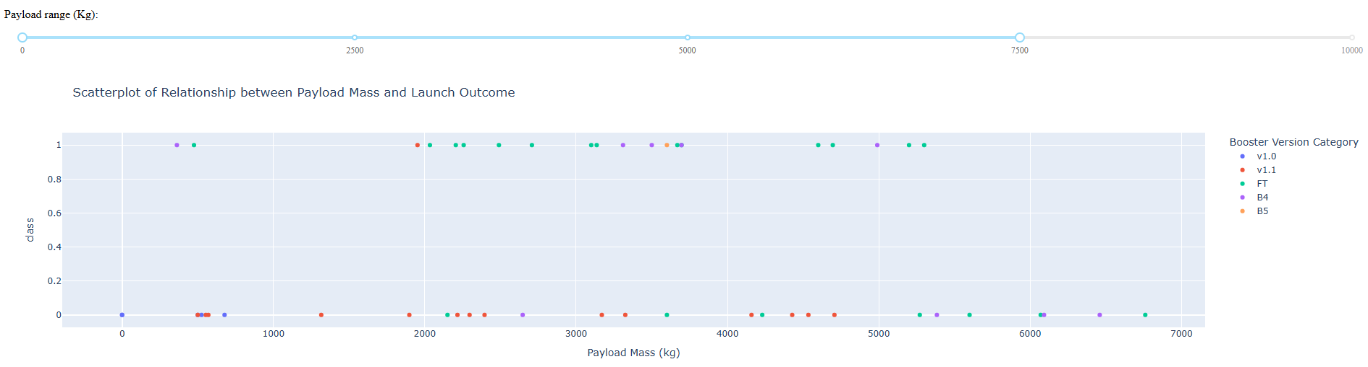
Relationship between Payload Mass and Launch outcomes
The scatterplot above showcases the relationship between payload mass and landing outcomes from all launch sites along with their booster version categories.
The payload range within the Dashboard can be adjusted with the range slider for better interpretation of the variables’ relationship.
It can be seen from the plot above that most successful launches are associated with the Booster Version Category of “FT”, and most failure are associated with “v1.1”.
The Range between 2000kg to 6000kg can also be seen as the range with the highest success ratio according from the scatterplot

Slide 42
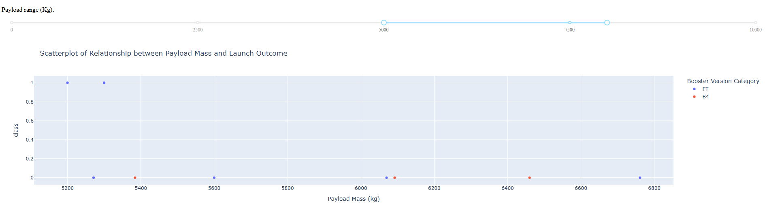
Lowest success ratio payload range
The scatterplot above showcases the relationship between payload mass and landing outcome from each launch within the payload mass range of 5000kg to 8000kg.
It can be seen from the plot above that most launches fail when it comes to the payload mass range between 5000kg to 8000kg, making this range as the lowest success ratio for launch outcomes.

Slide 43

Predictive analysis (Classification)
Section 5

Slide 44
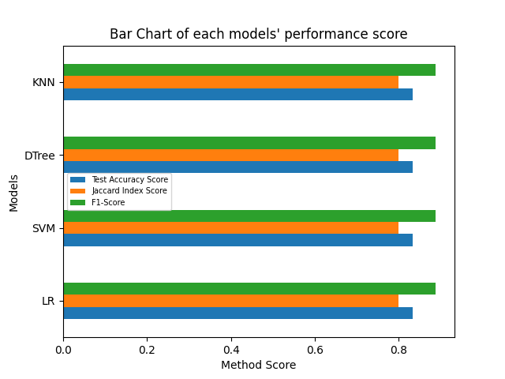
Classification accuracy
Based on the horizontal bar chart as shown,
All models displayed similar performance
With accuracy being 83.33% across all models.
However, as the sample size of the testing dataset was only 18, the result should be interpreted with cautions due to its small test sample size.
Such an issue may cause larger variances within the accuracy results, causing inaccurate value to be produced from overfitting or underfitting models
It is suggested that more testing sample should be collected for further analysis on model testing

Slide 45
Confusion matrix
*Correct predictions are on a diagonal from top left to bottom right.*
Since all models have the exact same performance based on the confusion matrix, all models are interpreted similarly.
All models were able to successfully predict 12 successful landings
All models were able to successfully predict 3 unsuccessful landings
All models had 3 false positive predictions where the models predicted 3 successful landings with their true label being unsuccessful landings
This shows that all models had a high accuracy in terms of predicting the success ratio of landing outcomes.
Though the previous cautions mentioned should also be taken into consideration for better interpretation of the models.

Slide 46
Conclusion
The initial goal of this current project was to develop machine learning models to predict the landing outcomes of the First Stage for Space Y
Data was collected from SpaceX API and Web-Scraped off SpaceX Falcon 9 Wikipedia.
The data were then used to perform EDA, where specific patterns in variables can be noticed and were collected as training data in training the machine learning models for during the EDA, such as:
Payload Mass, Flight Numbers, Orbit types and etc.
Dashboard and Folium maps were created for better visualization of further analysis
The final machine learning model building showcased 4 types of models with the same performance and accuracy of 83%, which in theory, any of the 4 models can be used for predicting landing outcomes of the First stage by Space Y.
However, Space Y should remain cautious while interpreting the models’ result as per mentioned, the model were tested on a small sample size, in which the data could potentially be inaccurate due to its large variances.
More sample testing data should be collected for further model building to determine the best performing models.

Slide 47
Appendix
Github URL for Full Capstone Project
https://github.com/TylerKoN/Data-Science-Capstone
Code Snippets in one URL:
https://github.com/TylerKoN/Data-Science-Capstone/blob/main/Appendix/Appendix.ipynb

Slide 48
Thank you
Capstone project by:
Tyler Lee

